Slide 1
Cache Coherence Enforcement Protocol Simulation & Evaluation
Siddhant Kulkarni
Ritesh Sangurmath
Ranjan Yadav
(Team #4)

Slide 2
Slide Contents
Memory Hierarchy
Introduction to Caches
Multiprocessor Architecture & Cache Coherence
Cache Coherence Protocols
Classification of Cache Coherence Protocols
Snooping Based Protocols
Directory Based Protocols
Hybrid Protocols
Protocols under evaluation
MSI
MESI
MOSI
MERSI
FIREFLY
DRAGON
Evaluation Parameters
Scope of Proposed Simulator
Experimental Methodology
Summary, Future Work and Conclusion

Slide 3
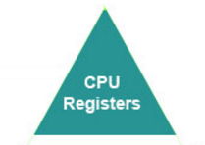


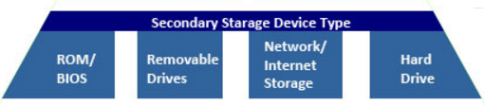
Memory Hierarchy

Slide 4
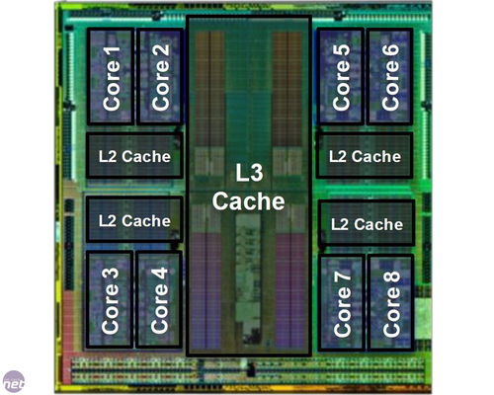
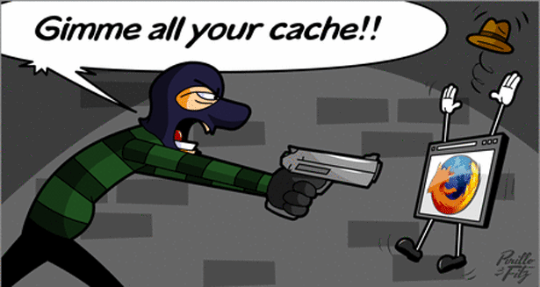

Introduction to Caches

Slide 5
Introduction to Caches, cntd.
High Speed Co-located Memory
Faster Access than the Physical Memory
Levels
L1: Extremely fast and small
L2: Capacity ++, Size ++, Speed --
L3: Capacity ++, Size ++, Speed --
Associativity
Direct Mapped
Two-way
Four-way
All-way
Notes:
To understand Cache Associativity: https://www.youtube.com/watch?v=ReKzEGLlGfk
[8]

Slide 6

Multiprocessor Architecture & Cache Coherence
P1
P2
L1-Cache
L1-Cache
X = 100
X = 1
X = 1
L2-Cache / Main Memory
X = 1
Y = 2
Z = 3
Notes:
Graphic from movie Deadpool

Slide 7
Cache Coherence Protocols
Protocols that make sure that Cache remains coherent
“Cache remains coherent” = Every processor gets consistent and updated values in their local cache
Notes:
[1][2][5]

Slide 8
Slide Contents
Memory Hierarchy
Introduction to Caches
Multiprocessor Architecture & Cache Coherence
Cache Coherence Protocols
Classification of Cache Coherence Protocols
Snooping Based Protocols
Directory Based Protocols
Hybrid Protocols
Protocols under evaluation
MSI
MESI
MOSI
MERSI
FIREFLY
DRAGON
Evaluation Parameters
Scope of Proposed Simulator
Experimental Methodology
Summary, Future Work and Conclusion

Slide 9
Classification of Cache Coherence Protocols
Coherence Protocols
Snooping Based
Hybrid
Directory Based

Slide 10
As a part of this project, we will be focusing on Snooping Based Protocols

Slide 11
Snooping Protocols
Aka Bus Snooping protocol
All caches monitor the bus and maintain state of cache blocks based on the transaction
If a cache notices that the copy it has is outdated, it takes required action
Very limited Scalability
Suitable to use when number of processors < 20
Notes:
[3][4]

Slide 12
Snooping Protocols, cntd.
P1
P2
P3
Read X
L1
L1
L1
Cache Controller/ Snooper
Cache Controller/ Snooper
P1 wants to read X
Cache Controller/ Snooper
P1 wants to read X
P1 wants to read X
Bus
P1 wants to read X
Main Memory
X=100
Y=200
Z=300
X=100

Slide 13
Let us say P2 got X in the same manner and now P2 wants to update the value of X…

Slide 14
Snooping Protocols, cntd.
P1
Write X=999
P2
Modified!
P3
INVALID!
L1
L1
L1
X=100
X=999
X=100
P2 Wants to Write X
Cache Controller/ Snooper
Cache Controller/ Snooper
Cache Controller/ Snooper
P2 Wants to Write X
P2 Wants to Write X
Bus
Main Memory
X=100
Y=200
Z=300
X=100

Slide 15
Snooping Protocols
Write-Invalidate
Processor that wants to change a copy of one of the blocks, it sends an invalidate message over the bus
Once the copies in all other caches are invalidated, the update is carried out
Example: MSI, MOSI, MESI, MERSI
Write-update
Updated value is broadcasted over the bus
Every processor that holds that block, updates the value in their cache
Example: DRAGON, FIREFLY

Slide 16
Directory Protocols
Centralised approach to maintaining coherence
Makes use of bit vectors to maintain which processor holds a copy of the block
Maintains similar states as Snooping protocols but aims at reducing the role of the bus
For improving scalability

Slide 17
Directory Protocols
P1
P2
P3
L1
L1
L1
Interconnection Network
Directory
Main Memory
X=100
Y=200
Z=300
<Tag, Location, State>
X=100

Slide 18

Snooping V Directory Dawn of Cache Coherence
Notes:
Graphic from : Batman V Superman Movie

Slide 19
Snooping V Directory
Snooping based protocols | Directory based protocols
Requests are broadcasted over the bus | Point to point requests are sent to and from processors
Dependency on bus causes bottlenecks | Does not depend on message transmission over bus
Each processor maintains the state of blocks in their own cache | Centralized state management
All coherence transactions are seen by every processors due to broadcast nature | Cache requests are unicast and thus do not utilize too much bandwidth
Snooping based protocols are faster | Directory based protocols are more scalable

Slide 20
Hybrid Protocols
Combination of Directory and Snooping
MESCIF[12]
Bandwidth aware
Less bandwidth available
Use Directory based Protocol
More bandwidth available
Use Snooping based Protocol
Others[14,15]

Slide 21
Slide Contents
Memory Hierarchy
Introduction to Caches
Multiprocessor Architecture & Cache Coherence
Cache Coherence Protocols
Classification of Cache Coherence Protocols
Snooping Based Protocols
Directory Based Protocols
Hybrid Protocols
Protocols under evaluation
MSI
MESI
MOSI
MERSI
FIREFLY
DRAGON
Evaluation Parameters
Scope of Proposed Simulator
Experimental Methodology
Summary, Future Work and Conclusion

Slide 22
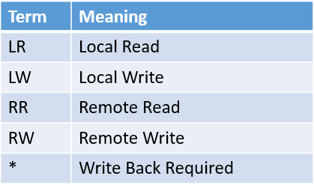
Protocols Under Evaluation
LW(Write Miss)
MSI
LR(Read Miss)
I
RW
RW*
M
S
LW
LR/LW
LR/RR
RR*
Notes:
[9][10]

Slide 23
Protocols Under Evaluation
MSI Transitions
 | LR | LW | RR | RW
M(modified) | M | M | S(WB) | I(WB)
S(shared) | S | M | S | I
I(invalid) | S(Read Miss) | M(Write Miss) | - | -

Slide 24
Protocols Under Evaluation
MOSI
MOSI is another variation of MSI protocol
It adds the “Owned” state to indicate that this is the most accurate and current copy of the block
Only one cache can hold a block in Owned state, others can have it in Shared state

Slide 25

Protocols Under Evaluation
RW
MOSI
I
LR/ Read miss
S
LR/RR
RW
RR*
LW/Write miss
RW*
LW
RR
M
LW
O
LW/RR
LR

Slide 26
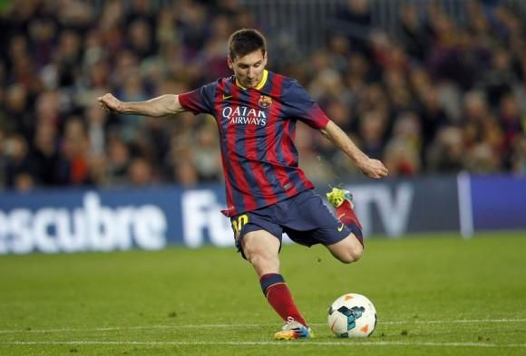
Protocols Under Evaluation
MESI
MESI is an upgraded version of MSI
MESI adds the “Exclusive (E)” state which is used to indicate that the local copy of a cache block is clean and it is the only copy of that block in any of the caches
Both MSI and MESI require only 2 bits to maintain state of a cache block
I
RW
E
LR
RW
LW
LW
RW*
RR
LR
LR/LW
LR/RR
M
LW
S
RR*
Notes:
Leonel Messi from Football Club of Barcelona

Slide 27
Protocols Under Evaluation
MERSI
MERSI is an extension of the MESI protocol
It adds the Read Only (R)
The processor is required to request a block into R state before it can transition to M (Modified)
Used in PowerPC G4

Slide 28
Protocols Under Evaluation
MERSI
I
RW
E
LR
RW
LW
RW*
RR
LR
LW (M via R)
LR/LW
LR/RR
M
LW
S
RR*
LW
LR
R

Slide 29


Protocols Under Evaluation
DRAGON
Four State Protocol
Valid(V) or Exclusive = Exclusive ownership, clean data
Shared-clean(SC) = Up to date copy shared by multiple caches, copy in shared cache/main memory may not be up to date
Shared-dirty(SD) = Current copy is modified, copy in shared cache/main memory is not up to date, other cache might have this in SC
Dirty(D) = Exclusive ownership, modified data
Instead of Invalid, every write is propagated to caches and written to memory at the time of replacement
Used by Xerox PARC
Notes:
Dragons from: Game of Thrones and How to train your dragon

Slide 30
Protocols Under Evaluation
Dragon
LR
LR/RR
v
RR
SC
LW(Shared)
/RW
LW(Not shared)
LW/RW
LR
RR
LW/LR
RR
LW(Not Shared)
LW/LR/RW
D
SD
LW(Shared)/RW

Slide 31


Protocols Under Evaluation
FIREFLY
Three state protocol
Valid Exclusive = Not modified, only copy in cache
Shared = Not modified, there might be copies in other caches
Dirty = Modified, propagation similar to DRAGON
Used in DEC Firefly Multiprocessor Workstation
Notes:
Firefly single season cancelled series

Slide 32
Protocols under evaluation
FIREFLY
LR(Not Shared)
LW(Not Shared)
LR/LW(Not Shared)
VE
D
LW(Not Shared)
LR (Not Shared)
RR/RW
RR/RW/LR(Shared)
LW/LR
(shared)
S
LW/LR(Shared)/
RR/RW

Slide 33
Slide Contents
Memory Hierarchy
Introduction to Caches
Multiprocessor Architecture & Cache Coherence
Cache Coherence Protocols
Classification of Cache Coherence Protocols
Snooping Based Protocols
Directory Based Protocols
Hybrid Protocols
Protocols under evaluation
MSI
MESI
MOSI
MERSI
FIREFLY
DRAGON
Evaluation Parameters
Scope of Proposed Simulator
Experimental Methodology
Summary, Future Work and Conclusion

Slide 34
Evaluation Parameters
# of Cache Read Misses
# of Cache Write Misses
# of Coherence Read Misses
# of Coherence Write Misses
# forced Write Backs
# entries to Invalid state
Delays added due to forced Write Backs
Notes:
[7][8]

Slide 35
Scope of Proposed Simulator
Input:
Number of Processors
Number of Cache blocks that can be stored by the individual L1 cache
Number of blocks in main memory
Write back delay to be considered
Cache transaction scenarios
Generated using sequence generator(provided in the simulator)
Manually Generated
Typed in
Choice of Protocol to be used (MSI, MESI, MOSI, MERSI, DRAGON, FIREFLY)
BEGIN!

Slide 36
Scope of the Proposed Simulator
Output
A visible execution of input sequence
Detailed log of state changes of all the cache blocks
Evaluation parameters mentioned in previous slides
Screenshot shows a sample of how the user interface of this simulator will look like:

Slide 37
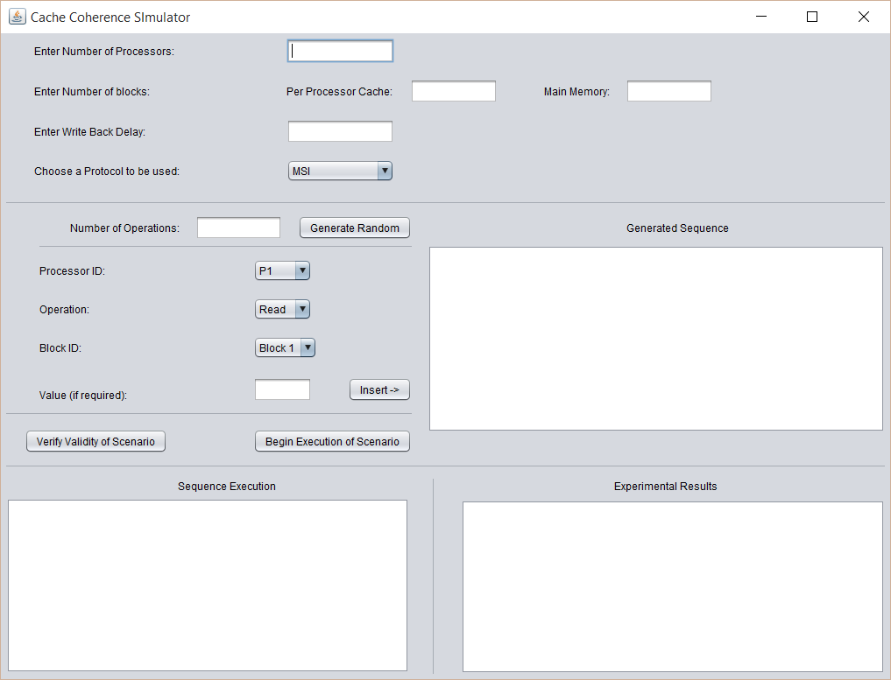
Scope of Proposed Simulator

Slide 38
Experimental Methodology
Sequences will be generated as test cases that will be executed using all different protocols.
We will also generate a set of sequences through a random sequence generator developed as a part of the simulator.
The scenario will be represented by a sequence of tuples:
<ProcessorID: Read or Write: BlockID: Value(only for write)>
Example: P1:R:1,P1:W:2:20,P2:R:7,P3:W:7…
The implemented protocols will all be used with the same set of sequences in order to evaluate the aforementioned parameters.

Slide 39
Conclusion
We will implement a simulator that will allow for different protocols to be integrated and evaluated for the purpose of cache coherence.
We will evaluate 6 Snooping based cache coherence protocols using different transaction scenarios.
The built simulator will allow for generation of access scenarios using a random sequence generator.
This sequence can be saved and used later for evaluation of other protocols.

Slide 40
Future Work
Additional considerations for possible future work:
Cache associativity
Cache access speeds
Memory access speeds
Impact of Cache Line Size
Graphical presentation of execution of sequence
Evaluation with a real architecture instead of simulation

Slide 41
Summary
Memory Hierarchy : it is a concept used when discussing performance issues in computer architectural design, algorithm predictions, and the lower level programming constructs such as involving locality of reference.
Caches: Cache is small high speed memory usually Static RAM (SRAM) that contains the most recently accessed pieces of main memory.
Cache Hits: When the cache contains the information requested, the transaction is said to be a cache hit.
Cache Miss: When the cache does not contain the information requested, the transaction is said to be a cache miss.
Cache Consistency : Snoop(When a cache is watching the address lines for transaction, this is called a snoop) and Snarf(When a cache takes the information from the data lines, the cache is said to have snarfed the data)

Slide 42
Summary
The inconsistencies : Dirty Data(When data is modified within cache but not modified in main memory, the data in the cache is called “dirty data.”). another one Stale Data(When data is modified within main memory but not modified in cache, the data in the cache is called stale data)
Cache Coherence: cache coherence is the consistency of shared resource data that ends up stored in multiple local caches. When clients in a system maintain caches of a common memory resource, problems may arise with inconsistent data, which is particularly the case with CPUs in a multiprocessing system.
Cache Coherence Protocols: A protocol for managing the caches of a multiprocessor system so that no data is lost or overwritten before the data is transferred from a cache to the target memory.

Slide 43
Summary
Snoopy Cache Protocol: distributed responsibility for maintaining cache coherence among all of the cache controller in the multiprocessor. Where it do write invalid & write update.
Write invalid protocol – there can be multiple readers but only one writer at a time, only one cache can write to the line.
Write update protocol – there can be multiple writer as well as multiple readers. When a processor wishes to update a shared line, the word to be distributed to all others, and caches containing that line can update it.
Directory Based Protocols: A single location (directory) keeps track of the sharing status of a block of memory. The (many) processing nodes are connected with a scalable interconnect (not a bus) hence, messages are no longer broadcast, but routed from sender to receiver since the processing nodes can no longer snoop, the directory keeps track of sharing state.

Slide 44
Slide Contents
Memory Hierarchy
Introduction to Caches
Multiprocessor Architecture & Cache Coherence
Cache Coherence Protocols
Classification of Cache Coherence Protocols
Snooping Based Protocols
Directory Based Protocols
Hybrid Protocols
Protocols under evaluation
MSI
MESI
MOSI
MERSI
FIREFLY
DRAGON
Evaluation Parameters
Scope of Proposed Simulator
Experimental Methodology
Summary, Future Work and Conclusion

Slide 45
References
[01]"What Is Cache Coherence? Webopedia Definition". Webopedia.com. N.p., 2016. Web. 29 Mar. 2016.
[02]"Cache Coherence". Wikipedia. N.p., 2016. Web. 29 Mar. 2016.
[03]James Archibald and Jean-Loup Baer. 1986. Cache coherence protocols: evaluation using a multiprocessor simulation model. ACM Trans. Comput. Syst. 4, 4 (September 1986), 273-298.
[04]"What Is Snooping Protocol? - A Definition from The Webopedia IT Dictionary". Webopedia.com. N.p., 2016. Web. 29 Mar. 2016.
[05]"Cache Coherence Problem - Georgia Tech - HPCA: Part 5". YouTube. N.p., 2016. Web. 29 Mar. 2016.

Slide 46
References
[06]"Cache Coherence". Slideshare.net. N.p., 2013. Web. 29 Mar. 2016.
[07]Lawrence, Ramon. "A survey of cache coherence mechanisms in shared memory multiprocessors." Proceedings of the International Conference on Advances in Computer Science and Electronics Engineering. 1998
[08]A. Agarwal, R. Simoni, J. Hennessy and M. Horowitz, "An evaluation of directory schemes for cache coherence," Computer Architecture, 1988. Conference Proceedings. 15th Annual International Symposium on, Honolulu, HI, 1988, pp. 280-289.
[09]Daniel J. S. Mark D. H. David A. W., “A Primer on Memory Consistency and Cache Coherence,” Morgan Claypool Publishers, 2011.
[10]"MESI, MOSI, MOESI Solution Quiz - Georgia Tech - HPCA: Part 5". YouTube. N.p., 2016. Web. 29 Mar. 2016.
[11]"19 5 L18S5 Cache Coherence Protocols". YouTube. N.p., 2016. Web. 29 Mar. 2016.

Slide 47
References
[12] S, M., & K, D. (2013). Hybrid Cache Coherence Protocol for Multi-Core Processor Architecture. International Journal of Computer Applications, 70(14), 24-29. doi:10.5120/12031-8060
[13] S. Al-Hothali, S. Soomro, K. Tanvir, R. Tuli, “Snoopy and Directory Based Cache Coherence Protocols: A Critical Analysis,” Information & Communication Technology, vol.4, no.1, pp.1,10, 2010.
[14] J. Li et al., "A New Kind of Hybrid Cache Coherence Protocol for Multiprocessor with D-Cache," Future Computer Science and Education (ICFCSE), 2011 International Conference on, Xi'an, 2011, pp. 641-645.
[15] J. Li, L. Shi, Q. Li, C. J. Xue and Y. Xu, "Thread Progress Aware Coherence Adaption for Hybrid Cache Coherence Protocols," in IEEE Transactions on Parallel and Distributed Systems, vol. 25, no. 10, pp. 2697-2707, Oct. 2014.

Slide 48


Slide 49
Thank you!

